Slide 1

CSE445 / CSE598
Distributed Software Development
Chapter 2
Lecture 06
Distributed Computing and Multithreading
-- Java and Python Multithreading
(Read Text Chapter 2)

Slide 2
Lecture Outline
Java Thread Class:
Constructors, methods, and properties
States and thread lifecycle
Starting a new thread: Two different ways:
Inheritance and runnable interface
Shard object/variable
Synchronized methods
wait and notify
Object locks and issues with locks
Synchronized statements
Python multithreading

Slide 3
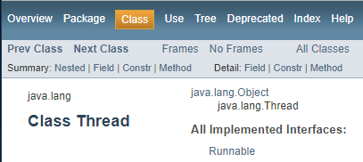
Thread Class in Java
https://docs.oracle.com/javase/7/docs/api/java/lang/Thread.html
Thread class is defined in the standard Java libraries.
Properties: MAX_PRIORITY, MIM_PRIORITY, NORM_PRIORITY.
Overloaded Constructors:
Thread();
Thread(String threadName);
Thread(Runnable threadObject);
Thread(Runnable threadObject, String threadName);
Thread(ThreadGroup groupName, String threadName)
Thread(ThreadGroup groupName, Runnable threadObject);
Thread(ThreadGroup groupName, Runnable threadObject, String threadName);

Slide 4
Thread Class in Java (Contd.)
Methods in Thread class:
static int activeCount(): Returns the number of active threads in the current thread's thread group
static Thread currentThread(): Returns a reference to the currently executing thread object.
void destroy(): Destroys this thread, without any cleanup
static int enumerate(Thread[] tarray): Copies into the specified array every active thread in the current thread's thread group and its subgroups.
String getName(): Returns this thread's name.
int getPriority(): Returns this thread's priority.
void setPriority(int newPriority): Change the priority of a thread.
void join(): Waits for this thread to die.
static void sleep(long millis)
static void sleep(long millis, int nanos)
void run()
void start()
…

Slide 5
Multithreading in Java: Thread life cycle
https://docs.oracle.com/cd/E18752_01/pdf/816-5137.pdf
Scheduling threads in ready queue:
By default, all threads have the same priority 5 (allowed: 1 - 10), and they are executed in round robin;
If a higher priority thread occurs, it preempts the lower priority thread and begins to execute.
Programmers make sure no starvation
creation
start
sleep
interval
expires
ready
quantum
expires
dispatch
notifyAll
unblocked
notify
wait
running
block
sleep
complete
waiting
sleeping
terminated
blocked
Text Section 2.4

Slide 6
Creating and Starting Threads in Java
Java provides two ways of creating a new thread:
Method A:
Create a subclass of the Thread class: MyThread
Override the run() method.
Create a thread with: new MyThread(...).
Start the thread by calling the start() method.
Method B:
Implement the Runnable interface.
Implements the run() interface.
Create a thread with new Thread(runnable).
Start the thread by calling the start() method.

Slide 7
Extending Thread Class: Method A
Text Section 2.4
For each thread that you want to create, you define a class that extends the Thread class.
A run method must be defined in this class, just like the main method of a single-thread program. You can have multiple classes, each with a run method, but you can have one class only with the main method.
class myThreadC1 extends Thread
{
// other members
public void run () {
// do something1
}
}
class myThreadC2 extends Thread
{
// other members
public void run () {
// do something2
}
}
public class TestMyThreads {
public static void main ( String args[] ) {
myThreadC1 threadA = new myThreadC1();
myThreadC1 threadB = new myThreadC1();
myThreadC2 threadC = new myThreadC2();
myThreadC2 threadD = new myThreadC2();
threadA.start();
threadB.start();
threadC.start();
threadD.start();
}
}

Slide 8

Method B: Implementing Runnable Interface
Extending the Thread class has a potential problem, as Java does not support multiple inheritance:
A Java class can extend one class only.
What can you do if your class has already extended a class, and you want to run it in multithreading?
Declare a user class that implements the Runnable interface. The user class implements the run method.
When creating a thread from the user class, use the library class Thread for creating an instance (worker process), and then pass the user’s thread object as an argument to the worker process:
Thread t = new Thread(new userClass());

Slide 9
Example using both Methods A and B
class myThreadC1 extends Thread { // Method A
int myID;
myThreadC1(int id) { // constructor with 1 parameter
myID = id;
}
public void run() {
for (int i = 1; i < 5; i++) {
int second = (int)(Math.random() * 500);
try {
Thread.sleep(second);
}
catch (InterruptedException e) { }
System.out.println("myThreadC1-id" + myID + ": " + i);
}
}
} //end class myThreadC1

Slide 10
Example implementing Runnable: thread2
class myThreadC2 implements Runnable { // Method B
int myID;
myThreadC2(int id) { // constructor with 1 parameter
myID = id;
}
public void run() {
for (int j = 1; j < 5; j++) {
try {
Thread.sleep((int)(Math.random() * 500));
}
catch (InterruptedException e) { }
System.out.println("myThreadC2-id" + myID + ": " + j*j);
}
}
} //end class myThreadC2

Slide 11
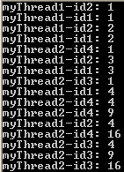
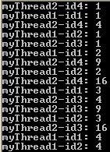
Creating and starting threads
public class testMyThreads {
public static void main(String[] args) {
Thread t1 = new myThreadC1(1); // Method A
Thread t2 = new Thread(new myThreadC1(2)); // B
Thread t3 = new Thread(new myThreadC2(3)); // B
Thread t4 = new Thread(new myThreadC2(4)); // B
t1.start();
t2.start();
t3.start();
t4.start();
}
} //end testMyThreads
UNIX fork() and exec()?
Notes:
In C# u don’t need method A

Slide 12
Example: Producer and Consumer
Produce an Integer
BufferClass
Consume an Integer
Thread 1
Hold an
Integer
Thread 2
main()
Notes:
BufferClass – to store data

Slide 13
Class that holds a shared variable
class BufferClass {
private int bufferCell = -1; // buffer for an integer
private boolean writeable = true; // flag
public void setBuffer(int val) {
while (!writeable)
{ }
bufferCell = val;
writeable = false;
}
public int getBuffer() {
while (writeable)
{ }
writeable = true;
return bufferCell;
}
}
setBuffer()
bufferCell
getBuffer()
writeable

Slide 14
Producer Class
Constructor with a parameter
class ProduceInteger extends Thread {
private BufferClass pBuffer;
public ProduceInteger(BufferClass h) { pBuffer = h; }
public void run() {
for (int count = 0; count < 10; count++) {
try {
Thread.sleep((int)(Math.random() * 3000));
}
catch (InterruptedException e) {
System.err.println(e.toString());
}
pBuffer.setBuffer(count); // put integer
System.out.println("Producer sets bufferCell " + count);
}
}
}
ProduceInteger
BufferClass
ConsumeInteger
Thread 1
Hold an
Integer
Thread 2

Slide 15
Consumer Class
Constructor with a parameter
class ConsumeInteger extends Thread {
private BufferClass cBuffer;
public ConsumeInteger(BufferClass h) { cBuffer = h; }
public void run() {
int val;
for (int count = 0; count < 10; count++) {
try {
Thread.sleep((int)(Math.random() * 3000));
}
catch (InterruptedException e) {
System.err.println(e.toString());
}
val = cBuffer.getBuffer();
System.out.println("\tConsumer retrieved " + val);
}
}
}
ProduceInteger
BufferClass
ConsumeInteger
Thread 1
Hold an
Integer
Thread 2
Notes:
Producer & consumer are referencing to the same buffer obj.

Slide 16
Main Program
Creating the buffer
public class ProducerConsumer
{
public static void main(String args[])
{
BufferClass h = new BufferClass();
ProduceInteger p = new ProduceInteger(h);
ConsumeInteger c = new ConsumeInteger(h);
p.start();
p.setPriority(Thread.NORM_PRIORITY-1);
c.start();
c.setPriority(Thread.NORM_PRIORITY+1);
}
}
Creating the producer and passing the buffer to it
Creating the consumer and passing the same buffer to it
Priority is not significant in this example, as one thread is blocked while other is running
Notes:
U can’t set priority bfr starting the thread only after starting.

Slide 17
What is wrong with the program?
class BufferClass {
private int bufferCell = -1; // buffer for an integer
private boolean writeable = true; // flag
public void setBuffer(int val) {
while (!writeable)
{ }
bufferCell = val;
writeable = false;
}
public int getBuffer() {
while (writeable)
{ }
writeable = true;
return bufferCell;
}
}
Not efficient
interrupt
Not efficient
interrupt

Slide 18
Synchronized Method and Statement
Synchronized method -- simpler:
class MyClass{ synchronized void aMethod(){ statements } }
Synchronized statement – more complex:
synchronized(obj){ statements }
Example:
synchronized(RandomCharacters.this){
// do something
RandomCharacters.this.wait();
}
Notes:
If u want to lock multiple obj’s use Synchronized method.
In C# , only Synchronized statement is available.

Slide 19
Example: Producer and Consumer
Produce an Integer
Hold an Integer
Consume an Integer
Thread 1
Synchronized
Thread 2
Buffer methods
main()

Slide 20
Buffer Class with Synchronized Methods
class BufferClass {
private int bufferCell = -1; // buffer for an integer
private boolean writeable = true; // flag
public synchronized void setBuffer( int val ) {
while ( !writeable ) {
try {
wait(); //voluntarily enter the wait state
}
catch ( InterruptedException e ) {
System.err.println("Exception: "+e.toString() );
}
} // end while
bufferCell = val;
writeable = false;
notify();
}
Questions:
Can interrupt occur?;
Can data be overridden if interrupt occurs?
Efficient
creation
start
ready
quantum
expires
dispatch
Interrupt?
notify
running
Release
wait
complete
waiting

Slide 21
Class with Synchronized Methods (contd.)
public synchronized int getBuffer() {
while (writeable) {
try {
wait(); //voluntarily enter the wait state
}
catch (InterruptedException e) {
System.err.println("Exception: " + e.toString());
}
}
writeable = true;
notify();
return bufferCell;
}
}

Slide 22
Synchronized Results
Producer sets bufferCell 0
Consumer retrieved 0
Producer sets bufferCell 1
Consumer retrieved 1
Producer sets bufferCell 2
Consumer retrieved 2
Producer sets bufferCell 3
Consumer retrieved 3
Producer sets bufferCell 4
Consumer retrieved 4
Producer sets bufferCell 5
Producer sets bufferCell 6
Consumer retrieved 5
Consumer retrieved 6
Producer sets bufferCell 7
Consumer retrieved 7
Producer sets bufferCell 8
Consumer retrieved 8
Consumer retrieved 9
Producer sets bufferCell 9
The thread is interrupted before printing; The results are still correct!

Slide 23
Synchronized methods can be interrupted
class ProduceInteger extends Thread
{
…
pBuffer.setBuffer(count);
System.out.println("Producer sets bufferCell " + count);
}
class ConsumeInteger extends Thread
{
…
val = cBuffer.getBuffer();
System.out.println(" \tConsumer retrieved " + val);
}
bufferCell
6
5
Producer sets bufferCell 5
Producer sets bufferCell 6
Consumer retrieved 5
Consumer retrieved 6

Slide 24
Waiting for Child Threads to complete
Two problems if main terminates first:
The OS may kill all child processes;
The buffer object created in main will be deleted.
public class myMainClass {
public static void main(String[ ] args)
{
int originalThreadCount = Thread.activeCount();
System.out.println("thread count=" + originalThreadCount);
for (int j = 0; j < 1; j++) {
Thread producer = new Thread(new producerThread(j));
Thread consumer = new Thread(new consumerThread(j));
producer.start();
consumer.start();
System.out.println("main thread count=" + Thread.activeCount());
}
while (Thread.activeCount() > originalThreadCount) // another way is to use join()
{
System.out.println("The remaining thread count = " + Thread.activeCount() );
Thread.sleep(300);
}
}
} //end myMainClass

Slide 25
Thread Synchronization in Java
Mutual exclusion of threads.
When an object is created, a lock-bit will be created;
When an object is accessed by a synchronized method / statement, the lock-bit will be turned on: the object is locked until the method is completed.
When an object is locked, any synchronized thread attempting to access the object will be blocked.
When an object is unlocked, the blocked threads will be unblocked.
This mechanism is also called an intrinsic lock or monitor;

Slide 26
How is an Intrinsic Lock implemented?
Heap
creation
Threads accessing
the same object
start
thread 1
Lock: true/false
ready
thread 2
Object
. . .
dispatch
unblocked
thread n
. . .
running
block
Lock: true/false
Object
blocked
When a synchronized method accesses any object, the runtime checks if the lock is on/off.
If the lock is on (true), the thread trying to access the object will be blocked.
If the lock is off (false), and the accessing method is “synchronized”, the lock is turned on and then the thread can access the object. The lock is turned off when the synchronized method exits, and the blocked threads are unblocked.

Slide 27
Issues need to be aware of
If a synchronized method accesses many objects, all objects will be locked
It may cause unnecessary blocking and reducing the capability of parallel computing;
It can cause a deadlock.
Because all objects accessed will be locked, we do not need to specify the object!
An unsynchronized method can still access a locked object – no check will be made if a method is not synchronized -- for efficiency’s reason;
Re-entrant method: If a method reenters, it can acquire the lock that has been locked by its previous entrance.

Slide 28
Deadlock Scenario
Thread 1 holds Object 1 while waiting for Object 2
Thread 2 holds Object 2 while waiting for Object 1
A thread accesses Object 1 and then Object2
Heap
A thread accesses Object 2 and then Object1
Thread 1
Access Object1 {
…
Access Object2
}
Lock: true/false
Object1
Thread 2
Access Object2 {
…
Access Object1
}
. . .
Lock: true/false
Object2

Slide 29
Synchronized Statements: Fine-Grained Synchronization
We do not have to synchronize the entire method;
public void insertNode(String name) {
node n = new node(name);
synchronized(this) {
listCount++;
addNode(head, n);
}
display(head);
}
head
n
The statement locks the members in “this” object only!
If listCount is a static member in “myMainClass”, using “this” does not prevent the “listCount” and “head” being accessed by other unsynchronized threads!

Slide 30
Synchronized Statements:
public class myMainClass {
public static void main(String[ ] args) {
node head;
public static listCount = 0;
…
}
}
public void insertNode(String name) {
node n = new node(name);
synchronized(myMainClass) {
listCount++;
addNode(head, n);
}
display(head);
}
The statement will lock the myMainClass and the static variable listCount.

Slide 31
Refined Synchronized Statements
public void insertNode(String name) {
node n = new node(name);
synchronized(myMainClass) {
listCount++;
}
synchronized(myMainClass) {
addNode(head, n);
}
display(head);
}
Next Lecture:
Multithreading in C#.
C# does not support method synchronization. You must use statement synchronization. We will learn more in the next lecture.
This implementation will allow listCount and head to be accessed simultaneously, while preventing each variable being accessed simultaneously

Slide 32
Multithreading in Python: A Simple Example
import logging
# Logging is a means of tracking event occurrences
import threading
import time
from datetime import datetime
import random
# Global variables
writeable = True
bufferCell = 0
t = time.time()
# get current time in seconds since epoch as a float number

Slide 33
Multithreading in Python: Producer
def runProducer(id):
global writeable
global bufferCell
global t
myId = id
logging.info("Producer Thread %s: starts", myId)
i=0
while (t > time.time() - 10): # Run producer for 10 seconds
i=i+1
while (writeable == False):
delay = random.randint(1, 3)
logging.info("Producer delays: %d seconds", delay)
time.sleep(delay)
if (writeable == True):
logging.info("Producer %s: generates Item= %d", myId, i)
bufferCell = i;
writeable = False;
Notes:
U can pick any class as a thread in py, C#
in java u need to define a class & have a thread

Slide 34
Multithreading in Python: Consumer
def runConsumer(id):
global writeable
global bufferCell
myId = id
logging.info("Consumer Thread %s: starting", myId)
while (t > time.time() - 10) and (t > time.time() - 10):
while (writeable == True):
delay = random.randint(1, 5)
logging.info("Consumer %s delays %d: seconds", myId, delay)
time.sleep(delay)
if (writeable == False):
logging.info("Producer %s: receives Item= %d", myId, bufferCell)
writeable = True;

Slide 35
Multithreading in Python: Main
if __name__ == "__main__":
format = "%(asctime)s: %(message)s" # Define format
logging.basicConfig(format=format, level=logging.INFO, datefmt="%H:%M:%S")
logging.info("Main thread starts before creating child threads")
x = threading.Thread(target=runProducer, args=("P1",)) #Id
y = threading.Thread(target=runConsumer, args=("C1",)) #Id
z = threading.Thread(target=runConsumer, args=("C2",)) #Id
x.start()
y.start()
z.start()
logging.info("Main: waits for both threads to finish")
x.join() #Without join, Main will terminate before child thds
y.join()
z.join()
logging.info("Main thread: terminates")

Slide 36
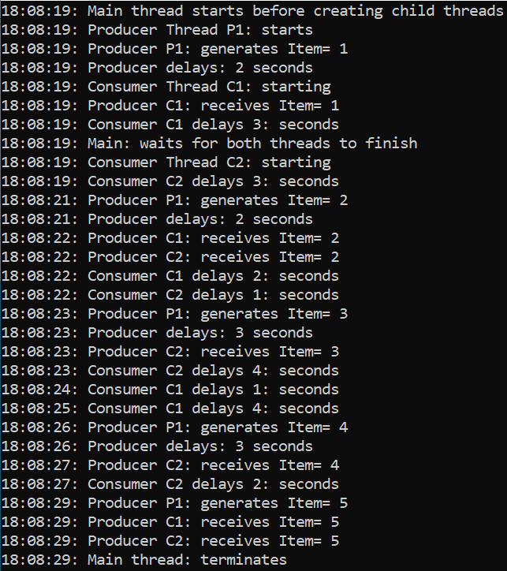
Output
Item 2 is taken by both C1 and C2 threads
Item 2 is taken by both C1 and C2 threads

